Slide 1
Gravitational Wave Template and its overlap
Hyung Won Lee, Inje University
with Chunglee Kim(SNU) and Jeongcho Kim(Inje University)

Slide 2
Contents
Motivation
CBC Inspiral GW Waveform
Time domain template
Frequency domain template
Overlap Calculation
Parameter Dependence of overlap
Remarks

Slide 3
Motivation
Theoretical derivation of GW template
Understanding LAL library

Slide 4
CBC GW sources
Neutron star / Black hole binary
Mass range : $1M_{⨀}\sim {10}^{3}M_{⨀}$
Frequency range : $1Hz \sim 10kHz$
Inspiral, Merger, Ringdown

Slide 5
CBC Inspiral GW Waveform

Slide 6
Gravitational Waveform
$h_{+}−ih_{×}=\sum_{ℓ=0}^{∞}{\sum_{m=−ℓ}^{ℓ}{Y_{ℓm}^{−2}\left(ı,φ\right)h_{ℓm}}}$
$Y_{ℓm}^{−2}\left(θ,φ\right)={\left(−1\right)}^{ℓ}Y_{ℓ,−m}^{−2}\left(π−θ,φ\right)$
$h_{ℓm}={\left(−1\right)}^{ℓ}h_{ℓ,−m}^{∗}$

Slide 7
Dominant mode
$h_{2,2}=−8\sqrt{\frac{5}{π}}\frac{Gμ}{c^{2}r}e^{−2iφ}x$ $\left\{\begin{aligned}\begin{aligned}\begin{aligned}\begin{aligned}1−\left(\frac{107}{42}−\frac{55}{42}η\right)x \\ +\left[2π+6i\ln\left(\frac{x}{x_{0}}\right)\right]x^{3/2}\end{aligned} \\ −\left(\frac{2173}{1512}+\frac{1096}{216}η−\frac{2047}{1512}η^{2}\right)x^{2}\end{aligned} \\ −\left[\left(\frac{107}{21}−\frac{34}{21}η\right)π+24iη+i\left(\frac{107}{7}−\frac{34}{7}η\right)\ln\left(\frac{x}{x_{0}}\right)\right]x^{5/2}\end{aligned} \\ +\left[\begin{aligned}\begin{aligned}\frac{27027409}{646800}−\frac{856}{105}γ_{E}+\frac{2}{3}π^{2}−\frac{1712}{105}\ln{2}−\frac{428}{105}\ln{x} \\ −18{\left[\ln\left(\frac{x}{x_{0}}\right)\right]}^{2}−\left(\frac{278185}{33264}−\frac{41}{96}π^{2}\right)η−\frac{20261}{2772}η^{2}+\frac{114635}{99792}η^{3}\end{aligned} \\ +i\frac{428}{105}π+12iπ\ln\left(\frac{x}{x_{0}}\right)\end{aligned}\right]x^{3}\end{aligned}\right\}$

Slide 8
Energy and flux in PN approx.
$ℰ\left(x\right)=−\frac{1}{2}ηx\left\{\begin{aligned}1−\left(\frac{3}{4}+\frac{1}{12}η\right)x−\left(\frac{27}{8}−\frac{19}{8}η+\frac{1}{24}η^{2}\right)x^{2} \\ −\left[\frac{675}{64}−\left(\frac{34445}{576}−\frac{205}{96}π^{2}\right)η+\frac{155}{96}η^{2}+\frac{35}{5184}η^{3}\right]x^{3}\end{aligned}\right\}$
$ℱ\left(x\right)=\frac{32}{5}η^{2}x^{5}\left\{\begin{aligned}\begin{aligned}\begin{aligned}1−\left(\frac{1247}{336}+\frac{35}{12}η\right)x+4πx^{3/2} \\ −\left(\frac{44711}{9072}−\frac{9271}{504}η−\frac{65}{18}η^{2}\right)x^{2}−\left(\frac{8191}{672}+\frac{583}{24}η\right)πx^{5/2}\end{aligned} \\ \left[\begin{aligned}\frac{6643739519}{69854400}+\frac{16}{3}π^{2}−\frac{1712}{105}γ_{E}−\frac{856}{105}\ln\left(16x\right) \\ +\left(\frac{41}{48}π^{2}−\frac{134543}{7776}\right)η−\frac{94403}{3024}η^{2}−\frac{775}{324}η^{3}\end{aligned}\right]x^{3}\end{aligned} \\ −\left(\frac{16285}{504}−\frac{214745}{1728}η−\frac{193385}{3024}η^{2}\right)πx^{7/2}\end{aligned}\right\}$
$η=\frac{m_{1}m_{2}}{{\left(m_{1}+m_{2}\right)}^{2}}$, $x={\left(\frac{GMω}{c^{3}}\right)}^{2/3}=v^{2}$, $μ=\frac{m_{1}m_{2}}{m_{1}+m_{2}}$

Slide 9
Time Domain Template
XLALSimInspiralChooseTDWaveform()
TaylorEt :
TaylorT1 :
TaylorT2 :
TaylorT3 :
TaylorT4 :
IMRPhenomA :
IMRPhenomB :
EOBNRv2HM : effective one body
EOBNRv2 :
SpinTaylorT2 :
SpinTaylorT4 :
PhenSpinTaylor :
PhenSpinTaylorRD :
SEOBNRv1 :

Slide 10
TaylorEt
Phys. Rev. D 80, 084043 (2009) , arxiv : 0907.0700
XLALSimInspiralTaylorEtPNGenerator()

Slide 11
TaylorT1
Numerical integration of equations
$\frac{dx}{dt}=−\frac{c^{3}}{GM}\frac{ℱ}{dℰ/dx}$
$\frac{dφ}{dt}=\frac{c^{3}}{GM}x^{3/2}$

Slide 12
TaylorT2
Parametric solution of TaylorT1
$t\left(x\right)=t_{c}+\frac{GM}{c^{3}}\int_{x}^{x_{c}}{\frac{1}{ℱ}\frac{dℰ}{dx}dx}$
$φ\left(x\right)=φ_{c}+\int_{x}^{x_{c}}{x^{3/2}\frac{1}{ℱ}\frac{dℰ}{dx}dx}$

Slide 13
TaylorT3
Solving TaylorT2 w.r.t. surrogate time
$Θ=\frac{η}{5}\frac{c^{3}\left(t_{c}−t\right)}{GM}$
$x=\frac{1}{4}Θ^{−1/4}\left\{1+\left(\frac{743}{4032}+\frac{11}{48}η\right)Θ^{−1/4}+⋯\right\}$
$φ=φ_{c}−\frac{1}{η}Θ^{5/8}\left\{1+\left(\frac{3715}{8064}+\frac{55}{96}η\right)Θ^{−1/4}+⋯\right\}$

Slide 14
TaylorT4
Expand $\frac{ℱ}{dℰ/dx}$ in TaylorT1, then integrate numerically
$\frac{dx}{dt}=\frac{64}{5}η\frac{c^{3}}{GM}x^{5}\left\{1−\left(\frac{743}{336}+\frac{11}{4}η\right)x+⋯\right\}$
$\frac{dφ}{dt}=\frac{c^{3}}{GM}x^{3/2}$

Slide 15
EOBNRv2HM
PRD84, 124052(2011)
XLALSimIMREOBNRv2AllModes()

Slide 16
EOBNRv2
PRD84, 124052(2011)
XLALSimIMREOBNRv2DominantMode()

Slide 17
SpinTaylorT2
arxiv : gr-qc/0405090, gr-qc/0310034
XLALSimInspiralSpinTaylorT2()

Slide 18
SpinTaylorT4
arxiv : gr-qc/0405090, gr-qc/0310034
XLALSimInspiralSpinTaylorT4()

Slide 19
PhenSpinTaylor
IMRPhenom references
XLALSimSpinInspiralGenerator()
Phenomenological waveform without ring-down

Slide 20
PhenSpinTaylorRD
IMRPhenom references
XLALSimIMRPhenSpinInspiralRDGenerator()
Phenomenological waveform with ring-down

Slide 21
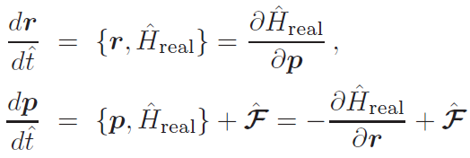
SEOBNRv1
PRD 86, 024011 (2012), arxiv : 1202.0790
XLALSimIMRSpinAlignedEOBWaveform()

Slide 22
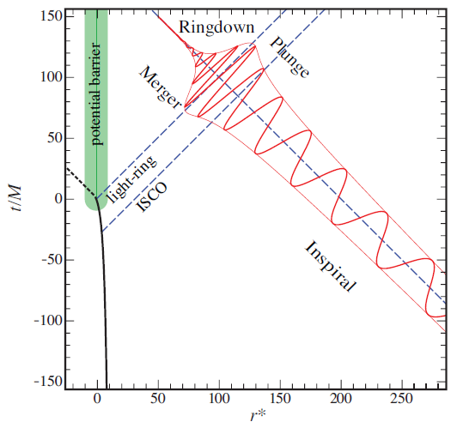
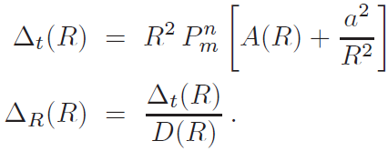
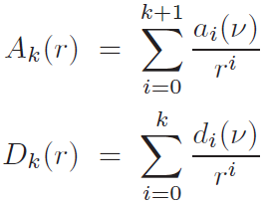
SEOBNRv1

Slide 23
Frequency Domain Template
XLALSimInspiralChooseFDWaveform()
TaylorF2
TaylorF2Amp
IMRPhenomA : non-spinning IMR model
IMRPhenomB : spinning IMR model
IMRPhenomC : non-precessing IMR model
IMRPhenomP : generic spins IMR model
SpinTaylorF2 : spinning inspiral
TaylorF2RedSpin : TaylorF2 reduced spin
TaylorF2RedSpinTidal : TaylorF2 reduced spin with tidal effect
TaylorF1, PadeF1, BCV, BCVSpin (not active)

Slide 24
TyalorF1
Solve equations

Slide 25
TaylorF2
arxiv : 0810.5336, 1303.7412, astro-ph/0504538
TaylorT2 using stationary phase approximation(SPA)
${\tilde{h}}_{+}\left(f\right)≈−\frac{1+\cos^{2}ı}{2}{\left(\frac{5π}{24}\right)}^{1/2}η^{1/2}\frac{G^{2}M^{2}}{c^{5}r}x^{−7/4}e^{\begin{aligned} \\ −2πift_{c}\end{aligned}}e^{2πiφ_{c}}e^{−iΨ(f)}$
${\tilde{h}}_{×}\left(f\right)≈i\cos{ı}{\left(\frac{5π}{24}\right)}^{1/2}η^{1/2}\frac{G^{2}M^{2}}{c^{5}r}x^{−7/4}e^{\begin{aligned} \\ −2πift_{c}\end{aligned}}e^{2πiφ_{c}}e^{−iΨ(f)}$

Slide 26
TaylorF2
$Ψ\left(x\right)=−\frac{π}{4}+\frac{3}{128}\frac{1}{η}x^{−5/2}\left\{1+\left(\frac{3715}{756}+\frac{55}{9}η\right)x+⋯\right\}$
$x={\left(\frac{πGMf}{c^{3}}\right)}^{2/3}=v^{2}$

Slide 27
IMRPhenomA
arxiv: 0710.2335, 0712.0343
XLALSimIMRPhenomAGenerateFD() XLALSimIMRPhenomAGenerateTD()

Slide 28
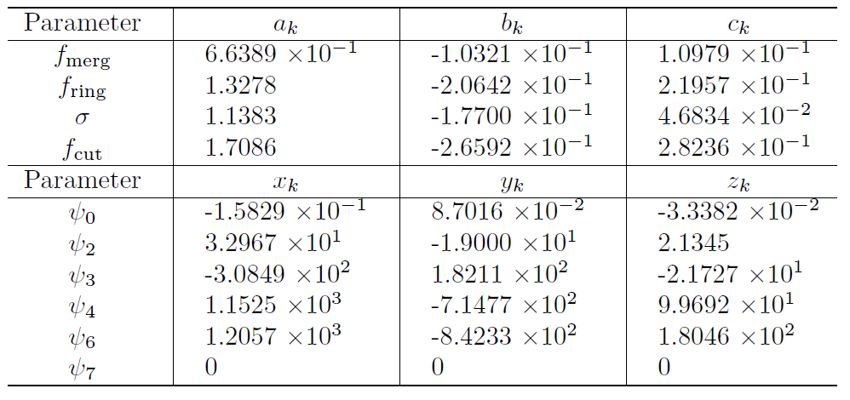
IMRPhenomA

Slide 29
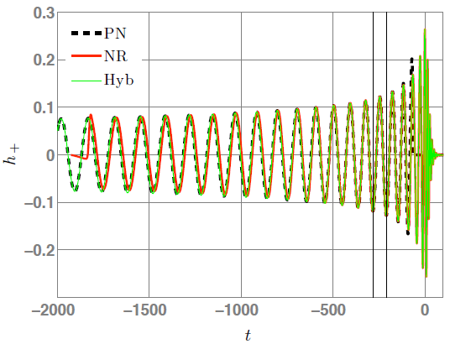
IMRPhenomA

Slide 30
IMRPhenomB
arxiv:0909.2867
XLALSimIMRPhenomBGenerateFD() XLALSimIMRPhenomBGenerateTD()

Slide 31
IMRPhenomB

Slide 32
IMRPhenomC
Phys.Rev.D82:064016,2010, arxiv:1005.3306
XLALSimIMRPhenomCGenerateFD() XLALSimIMRPhenomCGenerateTD()

Slide 33
IMRPhonemC

Slide 34
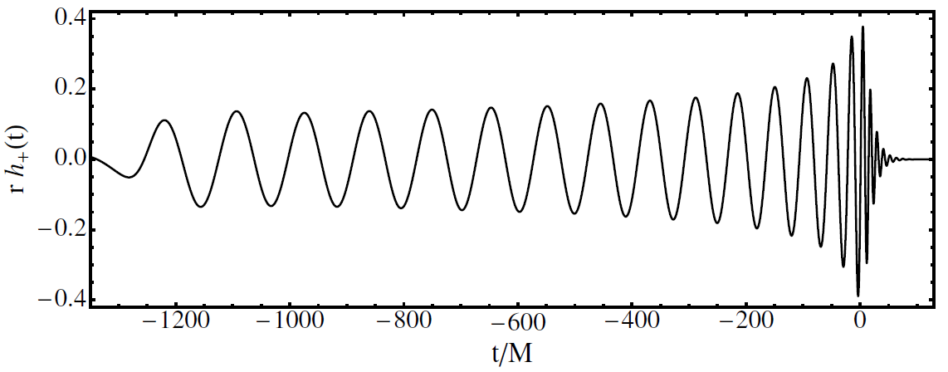
IMRPhonemC

Slide 35
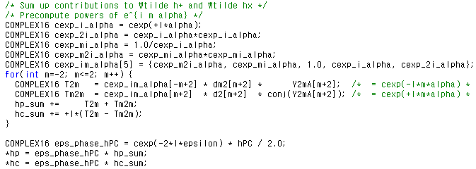
IMRPhenomP
arxiv:1308.3271
XLALSimIMRPhenomP()

Slide 36
SpinTaylorF2
arxiv: 0810.5336 (spin correction)
XLALSimInspiralSpinTaylorF2()
Spin correction to TaylorF2

Slide 37
TaylorF2RedSpin
arxiv: 1107.1267
XLALSimInspiralTaylorF2ReducedSpin()

Slide 38
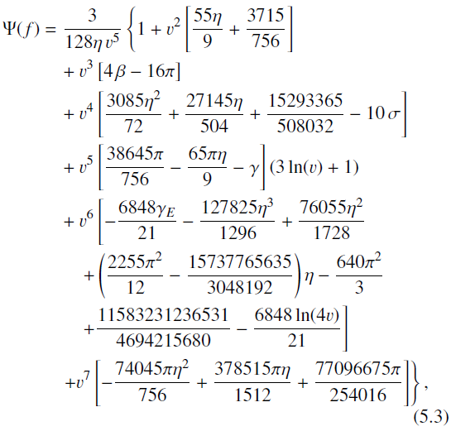
TaylorF2RedSpin

Slide 39
TaylorF2RedSpinTidal
arxiv: 1107.1267, 1101.1673
XLALSimInspiralTaylorF2ReducedSpinTidal()

Slide 40
TaylorF2Amp
arxiv : 0810.5336, 1303.7412, astro-ph/0504538
TaylorT2 using stationary phase approximation(SPA) and 2.5PN amplitude correction

Slide 41
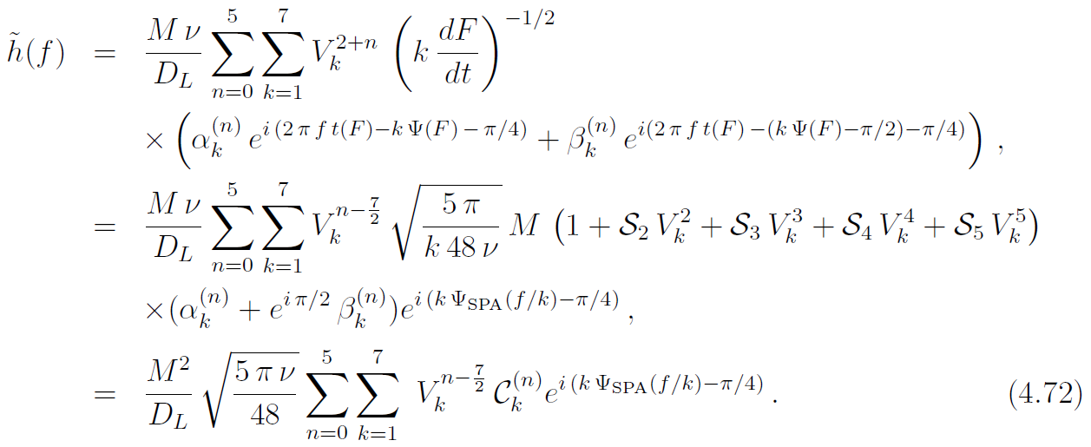
TaylorF2Amp
Arun et.al., PRD79, 104023(2009)
Amplitude corrections up to n=5 (2.5pN) are newly included

Slide 42
TaylorF2Amp
Phase corrections up to 3.5PN (standard in LAL)
+

Slide 43
TaylorF2Amp Codes
int XLALSimInspiralTaylorF2AmpPlus() Calculate $h_{+}$
int XLALSimInspiralTaylorF2AmpCross() Calculate $h_{×}$
REAL8 sf2_psi_SPA() Calculate $Ψ_{SPA}$
COMPLEX16 sf2_amp_SPA_plus(), cross() Calculate $∁_{k}^{(n)}$ for $h_{+}$, $h_{×}$

Slide 44
Overlap Calculation
Template
Data
$ρ=4\int_{0}^{+∞}{\frac{\tilde{h}(f){\hat{s}}^{∗}(f)}{S_{n}(f)}}df$
${SNR}^{2}=4\int_{0}^{+∞}{\frac{ {\left|\tilde{h}(f)\right|}^{2}}{S_{n}(f)}}df$
One-sided power spectral density of noise

Slide 45
Likelihood Calculation
LALInferencetest.c
$ℒ(s|λ)∝exp\left[−2\int_{0}^{∞}{\frac{{\left|\tilde{s}\left(f\right)−\tilde{h}(λ,f)\right|}^{2}}{S_{n}(f)}df}\right]$

Slide 46
Parameter dependence of Overlap
Physical parameters
1d graph : change just one parameter
2d graph : change two parameters
No Results Yet!
Binary | Chirp mass Mc (M_{sun}) | Symmetric mass ratio η | distance (Mpc) | Inclination (rad) | Polarization (rad) | Orbital phase (rad) | Coalescence time (s) | RA (rad) | Dec (rad)
NS-NS | 1.219 | 0.245 | 12.0 | 0.785 | 2.606 | 3.31 | 894383679 | 0.645 | 0.575
BH-NS | 2.9943 | 0.1077 | 23.1
BH-BH | 8.705 | 0.245 | 45.0

Slide 47
Remarks
Changing one parameter does not give the correct physics
We need marginalized distribution using MCMC or similar methods
Theoretical integration over some physical parameters will help very much for computation time

