Slide 1
AROMA-W
Ichiro Takahashi
Takanori Sakamoto
for the AROMA team
(Aoyama Gakuin University)

Slide 2
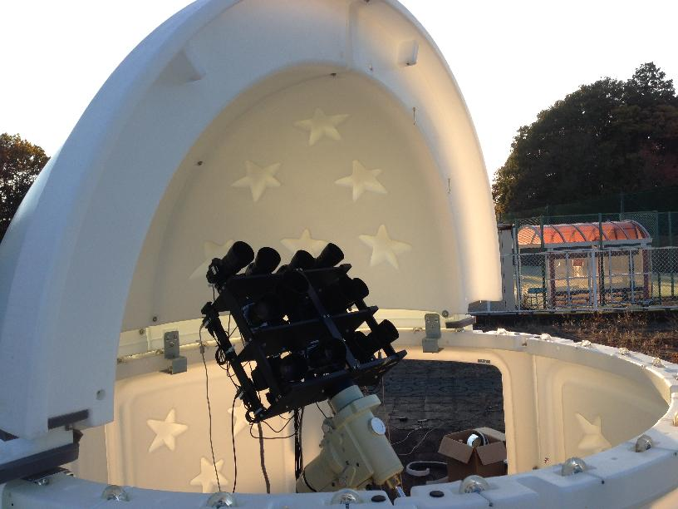
AROMA-W: (AGU Robotic Optical Monitor for Astrophysical objects, Wide-field)
Wide field optical monitor:
Commercially available digital cameras + telescope mount
SkyShed POD
Canon EOS 5D (Two)
+ 200 mm lens
Canon EOS 350D (Ten)
+ 100 mm lens
Mount: Takahashi EM-400 Temma2

Slide 3
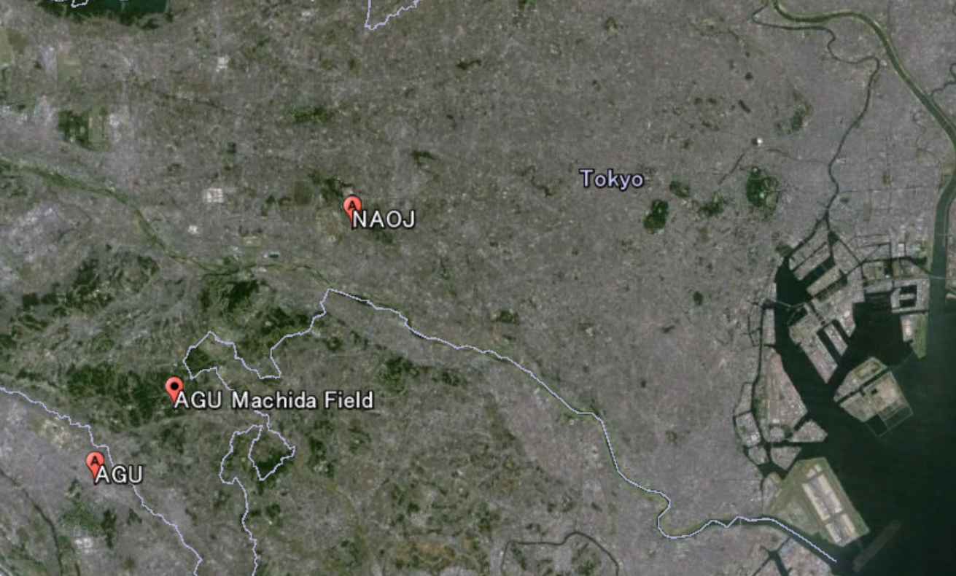
Observatory Location
AGU Machida Field
AGU’s facility (free internet, electricity, ..)
Good viewing
Relatively away from a city light
7.5km
N
E
S
W
N
30°

Slide 4
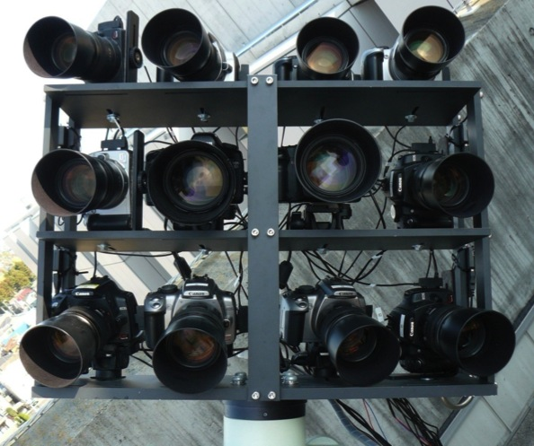
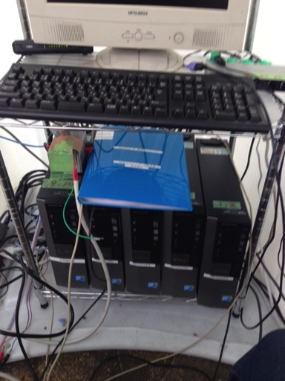
Observatory System
POD
PC3
Data Transfer
PC2
Data Transfer
Analysis PC
@ AGU Sagamihara Campus
USB2.0
USB2.0
Shutter control
Kiss 4
Kiss 3
Kiss 1
Kiss 2
PC1
Control
+
Data Transfer
USB2.0
Router
Kiss 5
5D2
5D
Kiss 10
Mount control
Kiss 6
Kiss 7
Kiss 8
Kiss 9
USB2.0
USB2.0
USB2.0
PC4
Data Transfer
PC5
Data Transfer
PC6
Data Transfer

Slide 5
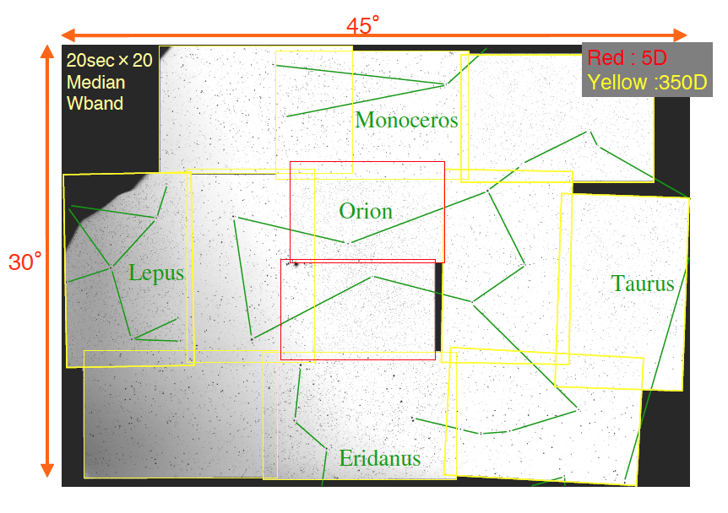
Wide filed of view observation in single shot!

Slide 6
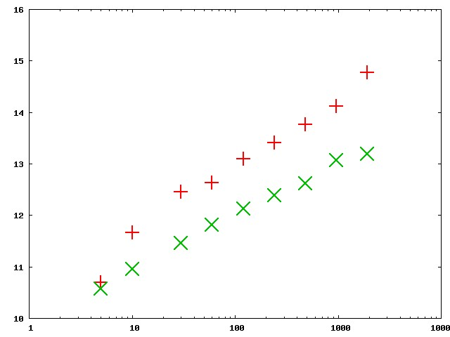
AROMA-W: Sensitivity
＋ : 5D
×: 350D
16
Combine
30 sec images
15
14
V Mag.
13
12
11
Data of Spring
3σ limit
10
1
10
100
1000
10000
Exposure time [sec]

Slide 7
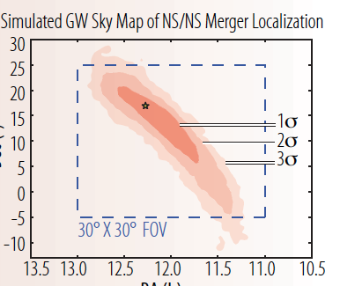
Follow-up optical observation of GW triggers
Dec [deg]
Camp et al. 2013
RA [h]

Slide 8
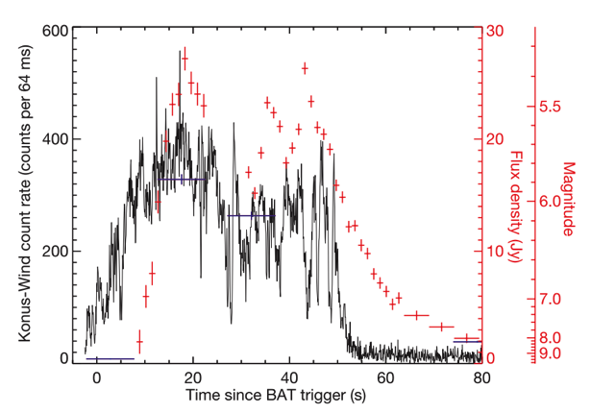
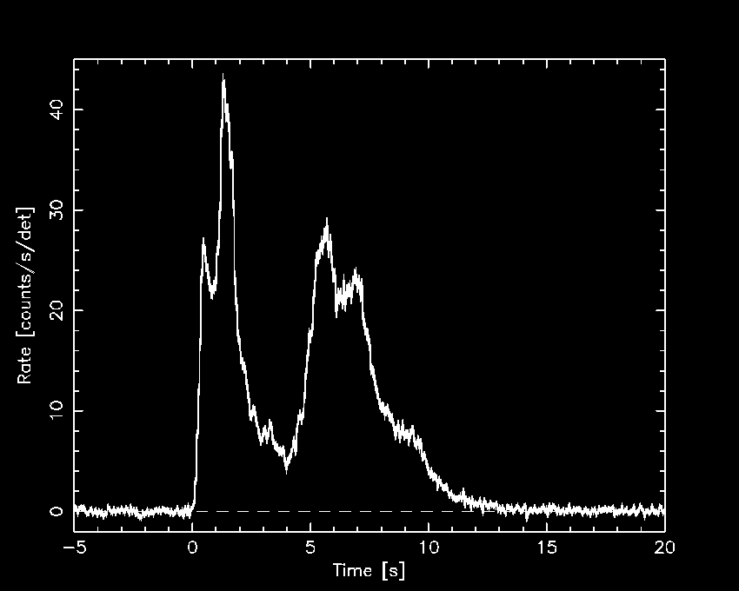
Optical observation before and during GRBs
Prompt optical observation of GRBs
Search for pre-burst optical emission of GRBs
GRB 050525A
Optical
?
X-ray
GRB 080319B: Racusin et al. 2008

Slide 9
Current Observation Strategy:
Chase the Swift pointing
- Swift’s pointing information is available through GCN
Test observation: 2014-01-28 16:58 UT: Swift’s target SN2014J
Red : 5D
Yellow : 350D

Slide 10
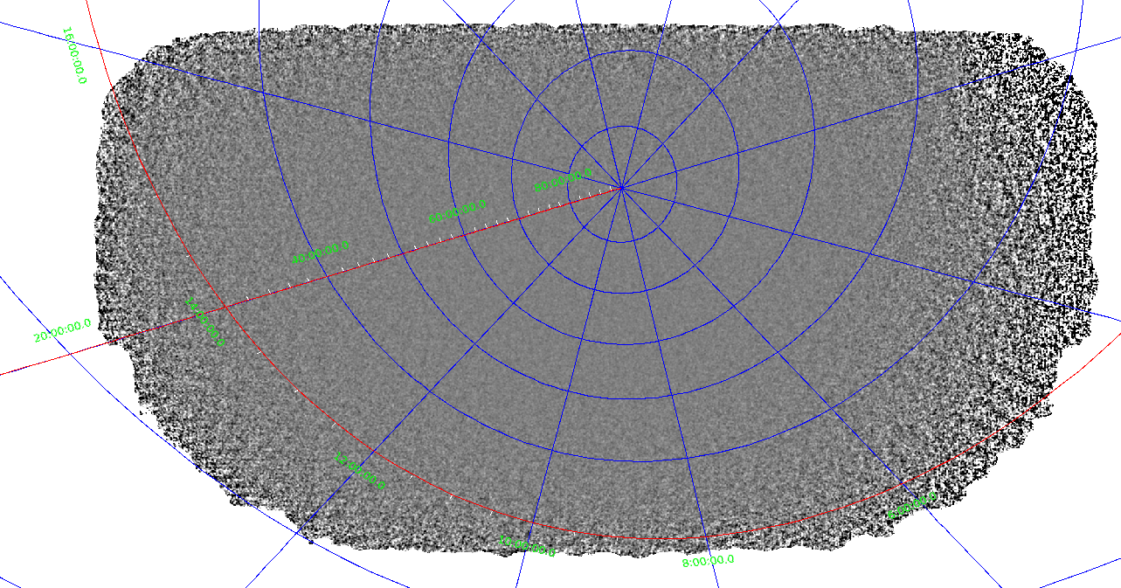
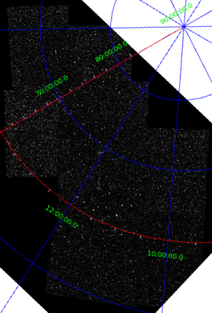
Overlaid image of AROMA-W and Swift/BAT
30°
45°
90°
120°

Slide 11
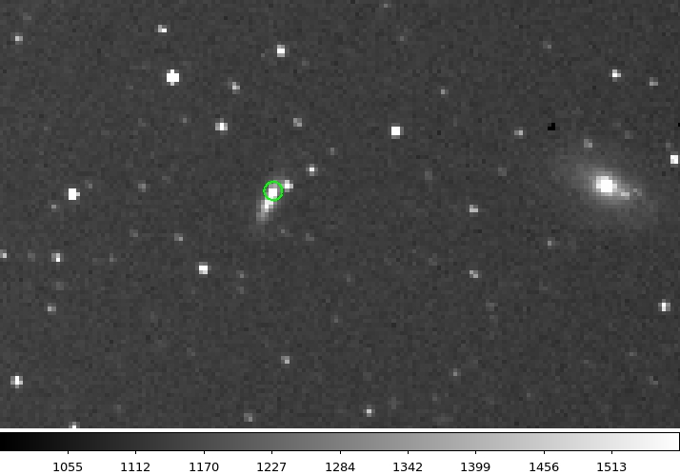
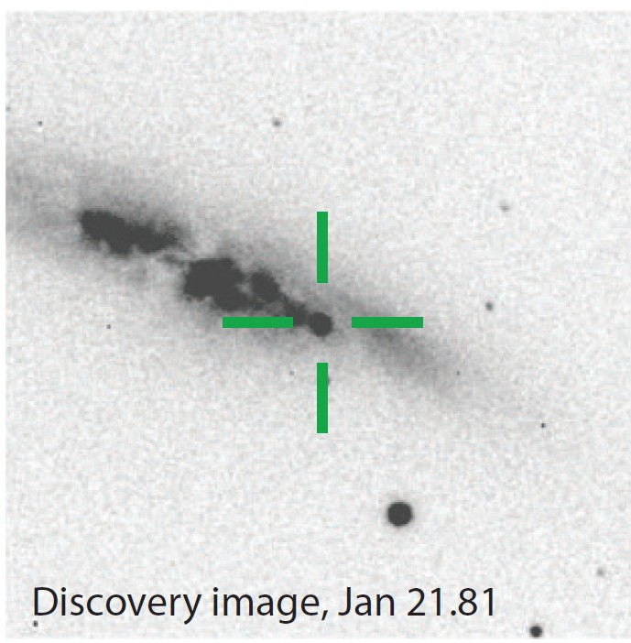
SN 2014J was visible by AROMA-W!
M82 with SN 2014J
(Jan. 21 )
Goobar et al. 2014
AROMA-W K2 combined image (Jan. 28, 800 s exposure)

Slide 12
Analysis pipeline
Data transfer
CF Memory in DSRL
Transfer PC
Analysis PC
Image processing
Analysis
RAW to FITS conversion
Star detection
Selection of comparison star
Data reduction
Make Star positional list
Tri-color resolution
Photometry
Positional correction
These processes are automated

Slide 13
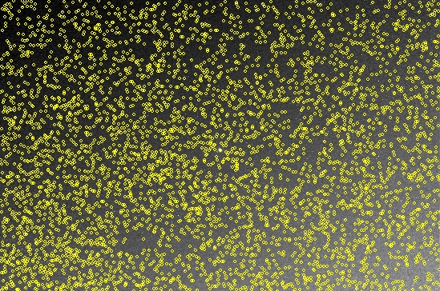
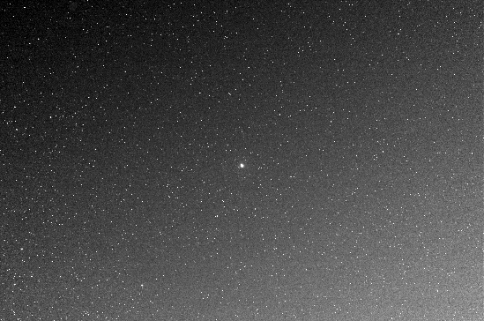
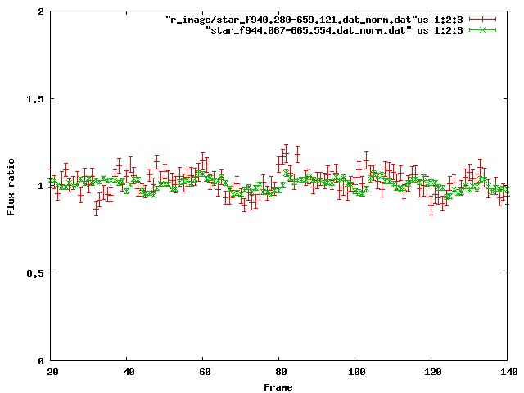
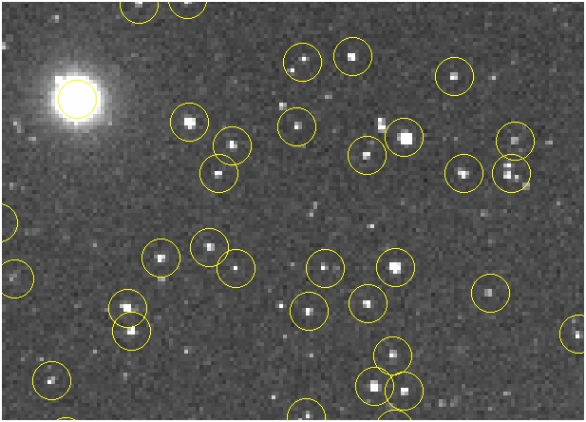
How to search variable stars and OTs
AROMA-W monitor the flux of all the objects in the F.O.V.
5D image
Threshold ：1.5σ 4 pixels over
～5000 objects
Red：R band
Green：W band
EOS 5D + EF 200mm 20sec
By monitoring these light curves
Search OTs and variable stars

Slide 14
Summary
AROMA-W is a wide-field optical monitor using multiple DSRL Cameras.
AROMA-W has very wide FOV, about 45°×30° in single shot.
AROMA-W’s 3σ limit V magnitude is 12 to 13 for 100 seconds exposure.
Science objectives of AROMA-W:
Follow-up optical observation of GW triggers
AROMA-W can cover 3σ conf. level area of GW transients at once.
Optical observation before and during GRBs
Currently, AROMA-W is chasing the Swift pointing.
It covers about 1/10 of the BAT FOV.
Basically analysis pipeline have already developed.

