Slide 1
J-GEM: Japanese Collaboration for Gravitational-Wave Electro-Magnetic Follow-up Observation
Michitoshi YOSHIDA
Hiroshima University

Slide 2
Purpose of J-GEM
Electro-magnetic follow-up of gravitational wave transients detected by advanced GW detectors (LIGO, Virgo and KAGRA)
Utilize existing optical, infrared, and radio astronomical facilities of Japanese institutes
Extension of A02 sub-project of the “Kakenhi” innovative area of “multi-messenger observations of GW sources”

Slide 3
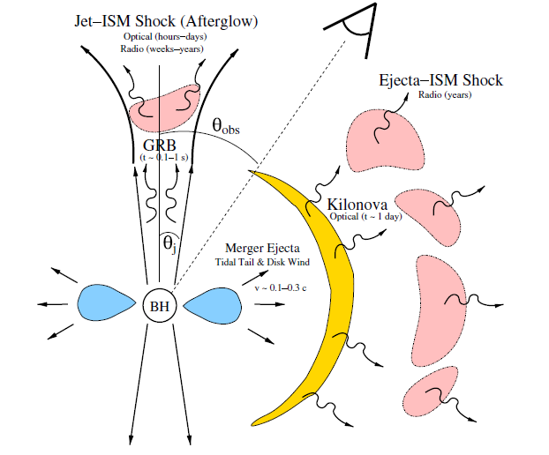
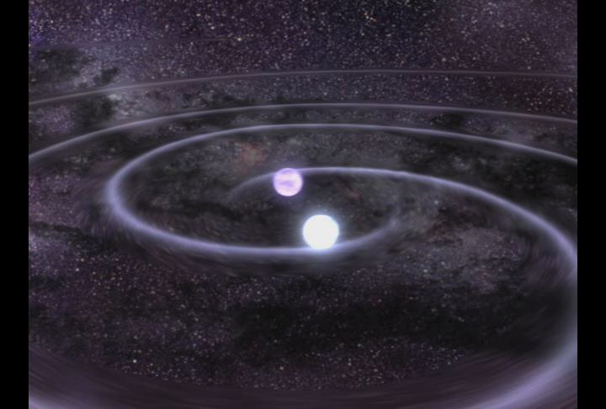
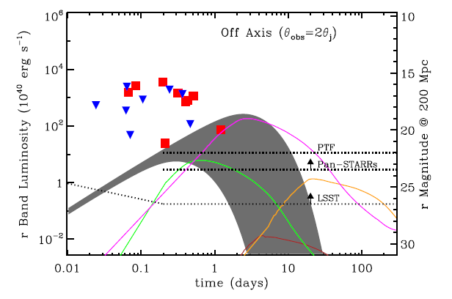
Searching for EM
counter part is crucial
for understanding the
nature of GW sources
Metzger & Berger 2012
The most promising GW
sources ➔ NS-NS merger

Slide 4
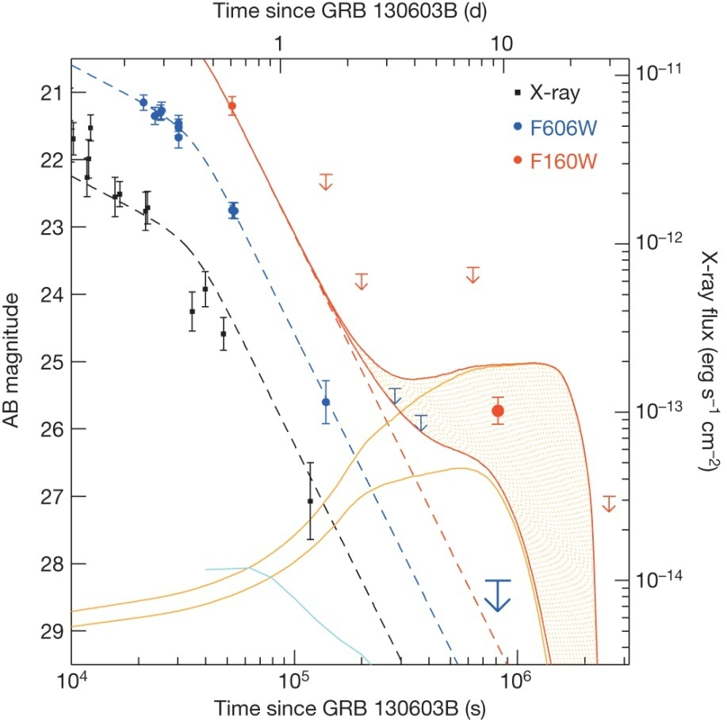
Optical, NIR and X-ray light curves of GRB130603B.
NR Tanvir et al. (2013)
Kilonova models
ejecta mass
10⁻¹ M
10⁻² M

Slide 5
Members
Michitoshi Yoshida (PI), Hiroshima University
Kouji Ohta, Kyoto University
Kentaro Motohara, University of Tokyo
Mamoru Doi, University of Tokyo
Tomoki Morokuma, University of Tokyo
Kenshi Yanagisawa, OAO, NAOJ
Masaomi Tanaka, NAOJ
Koji S. Kawabata, Hiroshima University
Takahiro Nagayama, Kagoshima University
Fumio Abe, Nagoya University
Kenta Fujisawa, Yamaguchi University
Nobuyuki Kawai, Tokyo Institute of Technology

Slide 6
Telescopes and Intruments
Katana Telescope: 1.5m optical-infrared telescope of Hiroshima University, Japan
HOWPol – optical imaging polarimeter and spectrograph. FOV=15’φ
HONIR – optical and near-infrared imaging spectrograph. FOV=10x10 arcmin2
Mini-TAO Telescope: 1m optical-infrared telescope of University of Tokyo, Chile
ANIR – Near-infrared camera. FOV=5x5 arcmin2
Kiso Schmidt Telescope: 1.05m Schmidt telescope of University of Tokyo. Location: Kiso Observatory, Japan
KWFC – optical wide-field camera. FOV=2.2x2.2 deg2
CMOS camera – optical wide-field imager (under development). FOV=6x6 deg2
OAO-WFC: 0.9m infrared telescope of NAOJ., Japan
Wide field near-infrared camera. FOV=0.92x0.92 deg2
MITSuME Telescopes: 0.5m optical telescopes of NAOJ and TITech, Japan
Optical three-color simultaneous camera. FOV=0.5x0.5 deg2

Slide 7
Telescopes and Intruments
IRSF: 1.4m infrared telescope of Nagoya University, South Africa
SIRIUS – near-infrared three-color simultaneous imager. FOV=7.7x7.7 arcmin2
Yamaguchi 32m Radio Telescope, 32m radio telescope of Yamaguchi University, Japan
6.7 GHz, 8 GHz, 22 GHz radio receivers
Kyoto 3.8m Telescope: 3.8m optical-infrared telescope of Kyoto University, Japan. (under construction)
Optical imaging spectrograph with integral field spectroscopy unit (IFU) FOV=15x15 arcsec2
HinOTORI Telescope: 0.5m optical telescope of Hiroshima University, China (under construction)
Optical three-color simultaneous camera. FOV=0.45x0.45 deg2
MOA-II: 1.8m optical telescope of MOA collaboration, New Zealand
Optical wide-field camera. FOV=1.5x1.5 deg2
Subaru Telescope: 8.2m optical infrared telescope of NAOJ, Hawaii, USA.

Slide 8
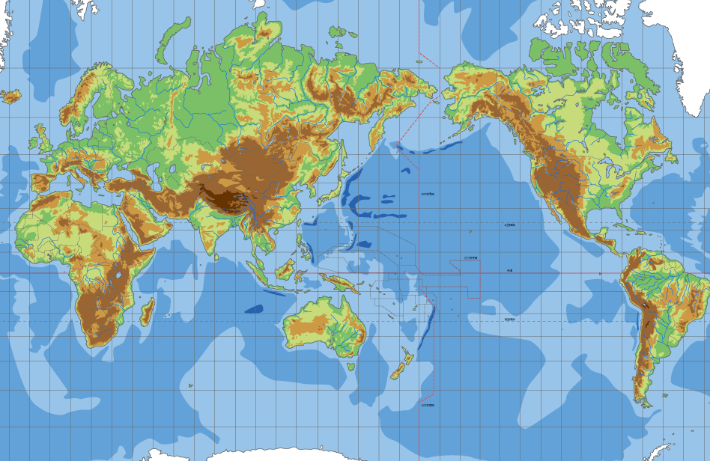
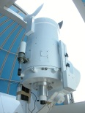
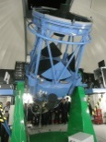
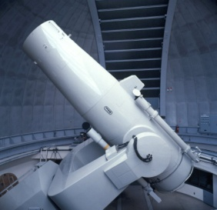
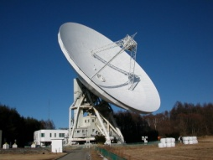
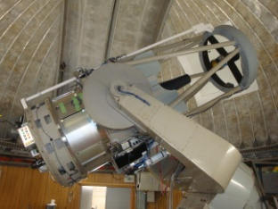
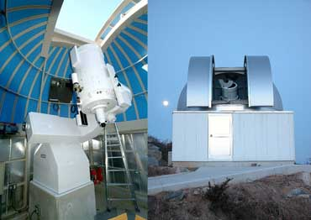
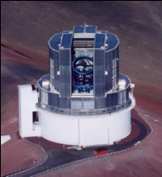
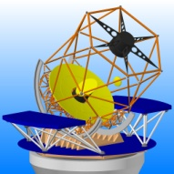
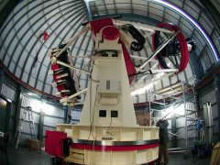
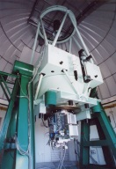
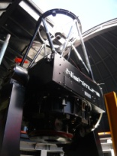
Japan Coordinated network for transients observation
A part of the project “Multi-messenger Observations of GW sources”
* collaborating with the KAGRA data analysis team
* science cases: GRBs, supernovae, blazars, etc.
Main features:
5 deg² opt. imaging w/ 1m
1 deg² NIR imaging w/ 1m
opt-NIR spectroscopy w/ 1–8m
opt-NIR polarimetry
1m Kiso Schmidt telescope
6 deg² camera ➔ 36 deg²
1.5m Kanata telescope
50cm MITSuME
91cm W-F NIR camera of NAOJ
1 deg² NIR camera
Yamaguchi 32m radio telescope
★
★
50cm telescope (Hiroshima Univ. 2014)
3.8m telescope (Kyoto Univ. 2015)
Subaru @Hawaii
★
★
★
IRSF (Nagoya Univ.) @ South Africa
miniTAO (Tokyo Univ.) @ Chile
MOA-II (Nagoya Univ.) @ New Zeeland

Slide 9
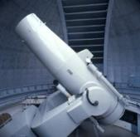
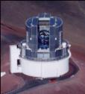
Schematic overview of the project
Detection of EM counterpart of GW transient
with wide-field observations
Multi-mode observations ➔
physics of EM counterpart
The nature
of GW transient
GW alert
LIGO/Virgo/KAGRA
alert
Wide field obs.
➔EM counterpart
Rapid identification
alert to other facilities
X-γ obs.
(A01)
Coop.
Kiso 6x6 deg²
Camera
MOA-II 1.5x1.5deg²
Camera
OAO IR WFC
Neutrino obs.
(A03)
Yamaguchi32m
NRAO 45m
Multi-wavelen.
➔detailed study
identification
emission mechanism
Multi-mode obs.
➔detailed study
redshift -> distance
emission mechanism
IRSF
World-wide obs.
➔long term monitor
event evolution
Kanata
Kyoto 3.8m
Coop.
miniTAO
Subaru
theory
(A05)
HinOTORI 50cm

Slide 10
New developments for J-GEM

Slide 11
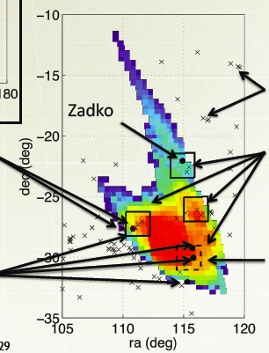
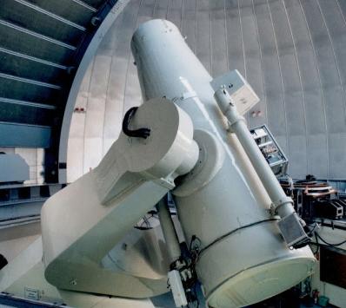
1. 6x6 deg² extremely wide field camera Kiso Observatory, the University of Tokyo
Project plans
1. Development of 6deg x 6deg extremely wide field camera
2. Speeding-up and stabilizing Kiso 105cm Schmidt telescope system
F.O.V
6deg x 6deg
・ 105cm Kiso Schmidt telescope
・ F.O.V of 6deg x 6deg
・ Since Apr. 2012, the KWFC (Kiso Wide Field Camera) with a F.O.V of 2deg x 2deg has been operated.
Results of simulation on estimation of an arrival direction of gravity wave. Hayama (NAOJ) 2012

Slide 12
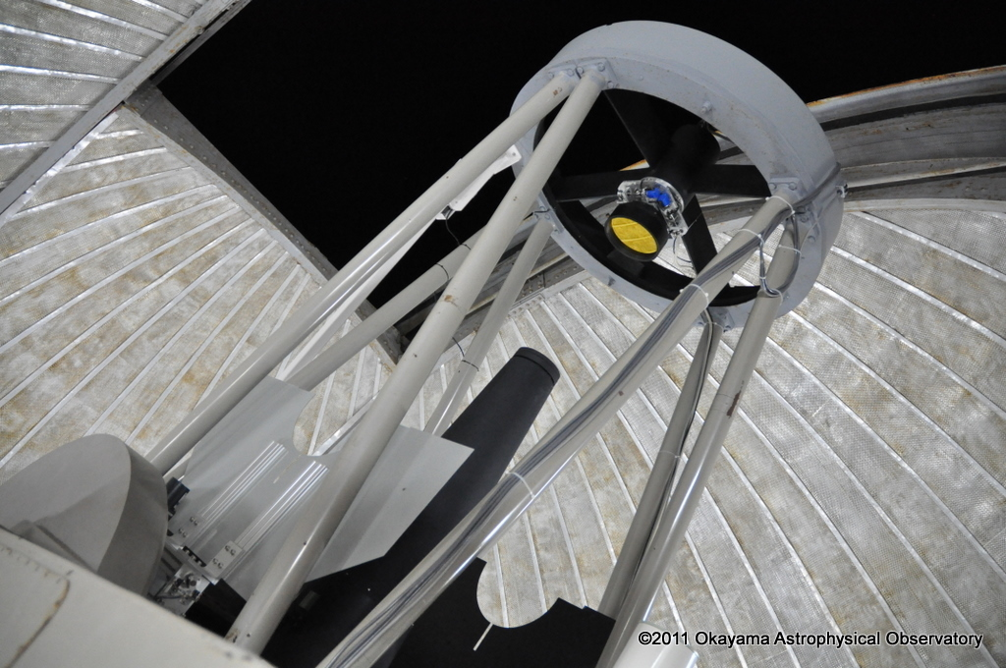
2. OAOWFC Okayama Astrophysical Observatory Wide Field Camera

Slide 13
OAOWFC Okayama Astrophysical Observatory Wide Field Camera
Wide Field NIR Camera
Optics:
Effective Diameter: φ 0.91 m
Forward Cassegrain + quasi Schmidt
F/2.5 (the fastest optics in the NIR)
F.O.V.： 0.92 × 0.92 sq.deg. （1.62 arcsec/pix）
HAWAII2-RG, Teledyne
0.47 x 0.47 sq.deg. (1.67 arcsec/pix) HAWAII Eng., Teledyne
Wavelengths：0.9 – 2.5 um (Y,J,H,Ks-band)
Detection limit (S/N=5 with 10 min.exp.):
19.8 ABmag @J-band

Slide 14
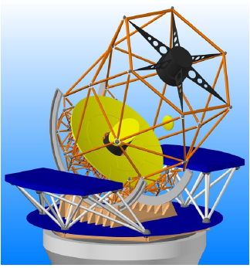
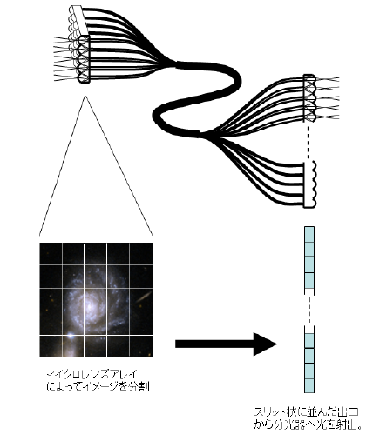
3. Integral Field Unit for 3.8m telescope
Integral Field Unit
FoV ~ 30”x30”
optical wavelength
R~1000-3000
=>spectrograph
Planned
3.8m telescope
at Okayama
Conceptual view
of IFU

Slide 15
4. HinOTORI 50cm telescope
Development of a 50cm robotic telescope + 3-color camera system
➔ West China (Tibet area)
Expected limiting mag. (S/N=5 for 10 min exp.)
18.5 mag. u’-band
21.1 mag. R_{c}-band
20.8 mag. I_{c}-band

Slide 16
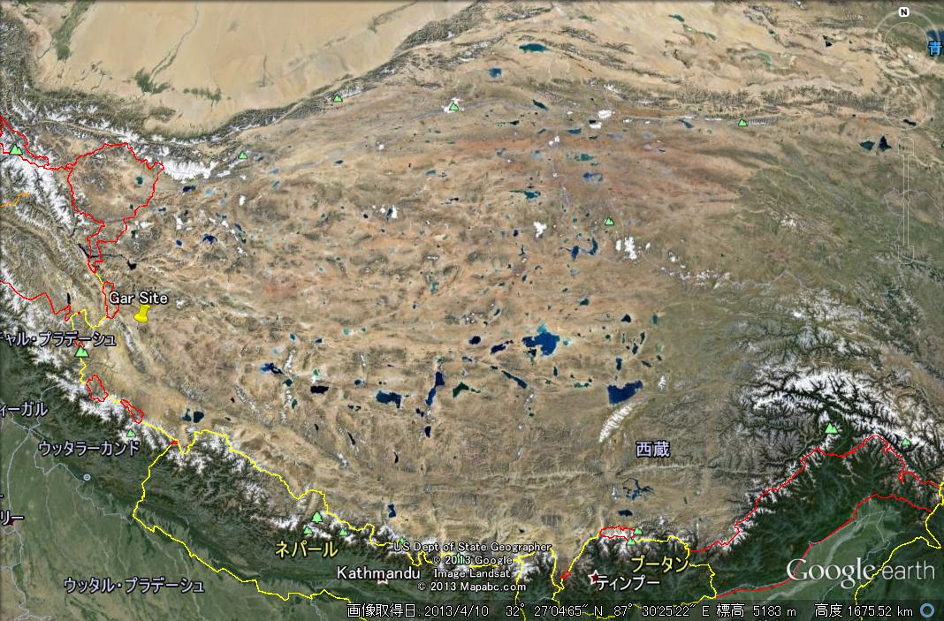
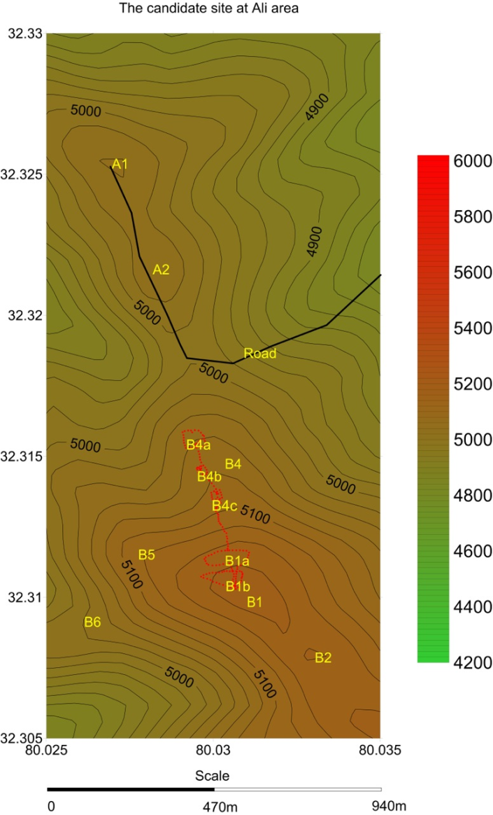
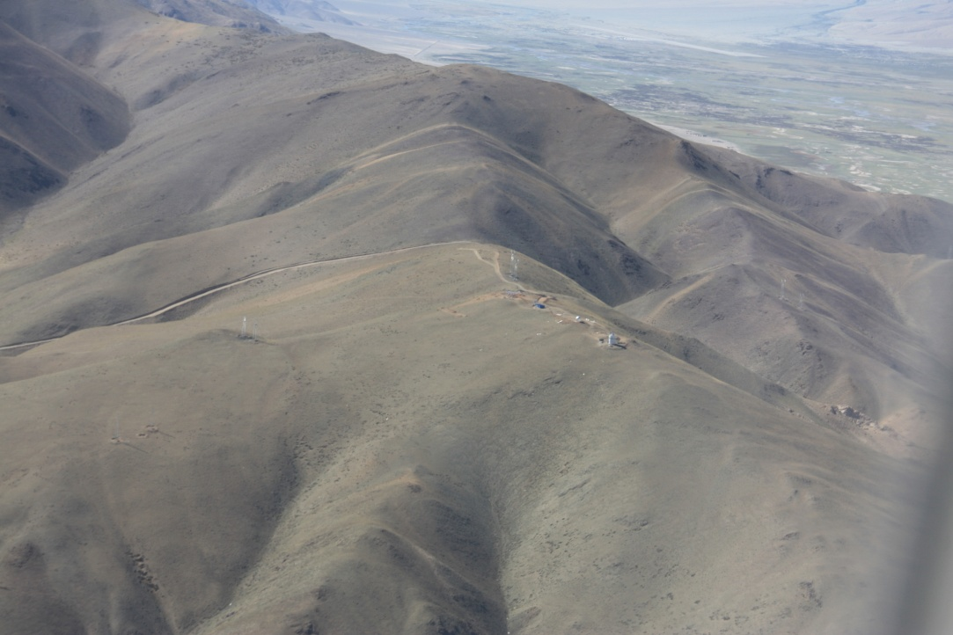
Candidate site for the telescope
West end of Tibet:
～60 degree west from Japan
altitude: 5000m
Gar
Tibet
Lhasa
B1
B4
A2
A1

Slide 17
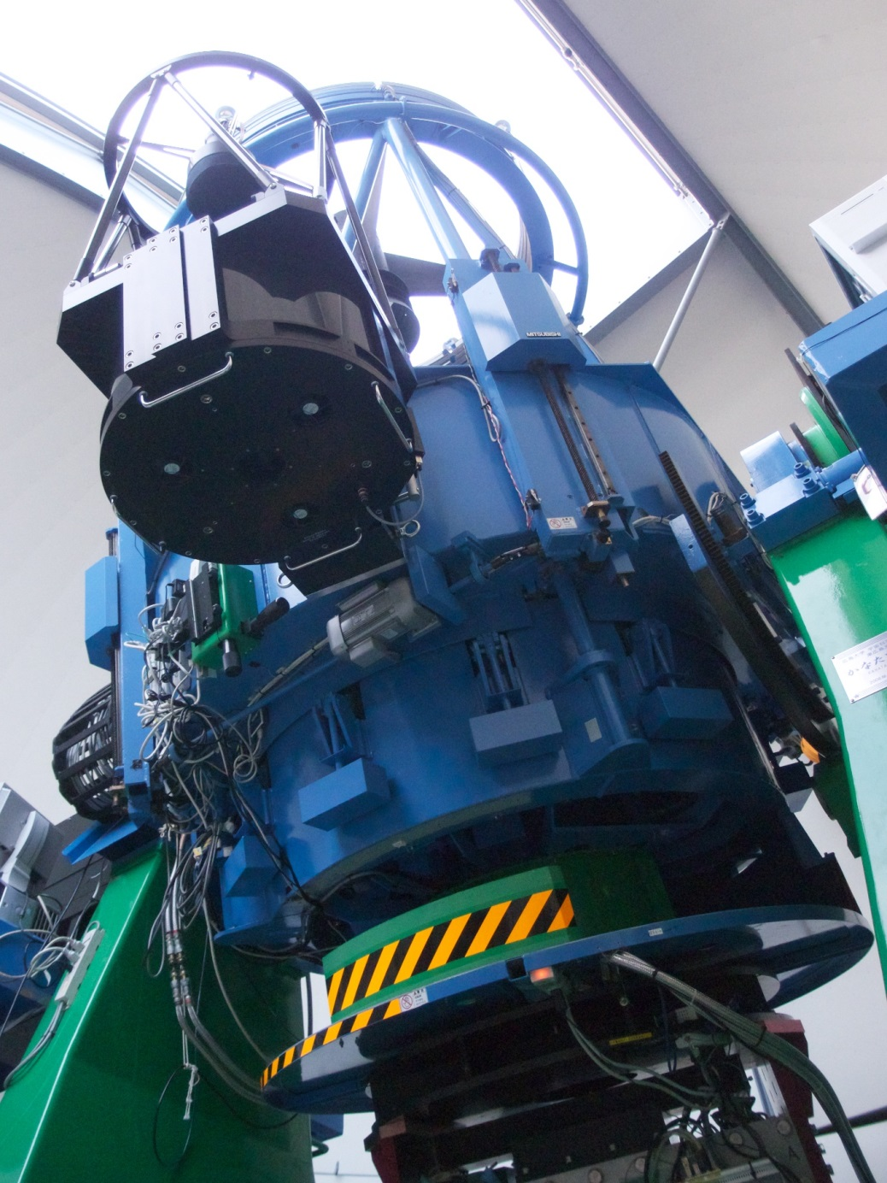
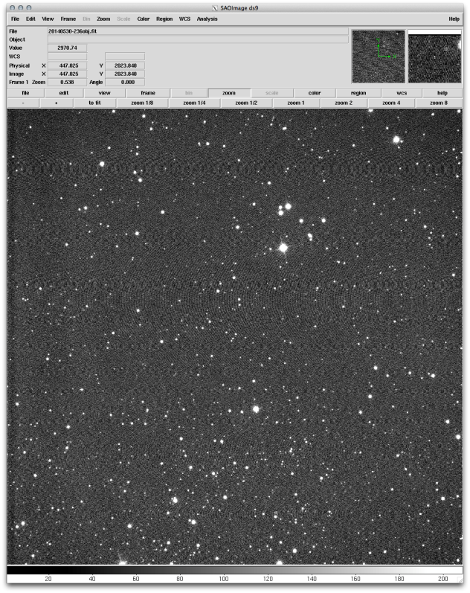
Performance verification of the 50cm telescope by attaching it to Kanata telescope.
HinOTORI 50cm telescope
1.5m Kanata
telescope
Test image:

Slide 18
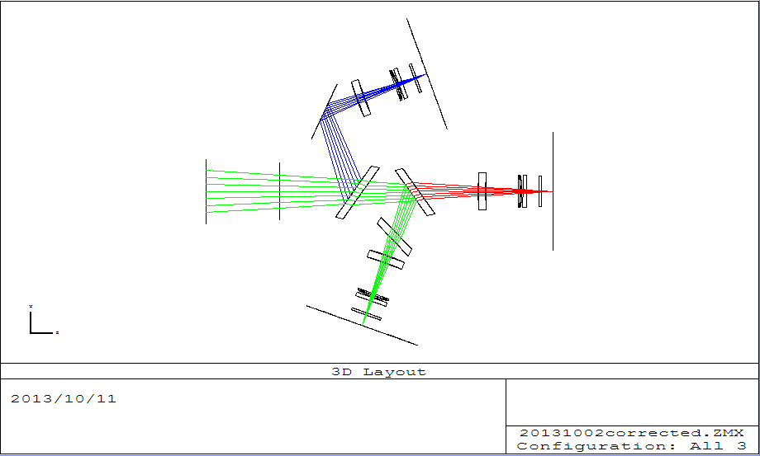
Optical Layout of the 3-color camera
FOV: 24 arcmin^2
u’ band
telescope
Ic band
dichroic mirror
dichroic mirror
Rc band

Slide 19
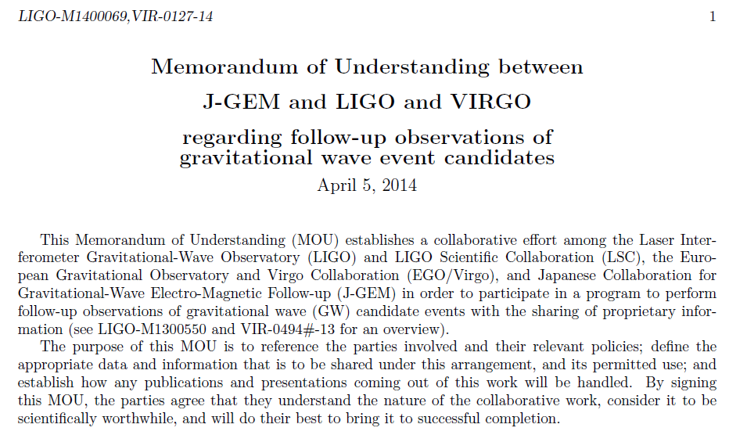
MoU with LIGO/Virgo collaboration

Slide 20
How do we plan to use them for this project?
We are now developing a multi-site observation network for searching for electromagnetic counterpart of gravitational wave transient using the above telescopes.
We utilize this network for LIGO/Virgo GW search. The basic strategy is very simple:
We try to detect optical-infrared transients in high probability area of GW skymap using wide-field telescopes, #3, #4, and #7.
We use telescopes #2, #5, #6, and #10 for surveying peripheral region of the best area or second probable region of the skymap. In this search, we plan to weight the observation regions using nearby galaxy catalog.
After picked up transient candidates, we follow-up the objects using other telescopes. If we detect a clear signal, we do spectroscopic follow-up using telescopes #1, #8, and #11, and radio observation with telescope #9.

Slide 21
How promptly do we expect to be able to have results?
It depends on the nature of the transients. We can deliver initial results of each observation within 1 day, probably, within a few hours, by using the pipeline data reduction systems installed at each observatory/institute.

Slide 22
Source identification strategy
Pipeline software for transient detection for KISS project
Image subtraction method to detect transient point sources
← reference images: SDSS, 2MASS, Pan-STARRS, etc.
If there is no reference image available, detect all the point sources in the object image.
Catalog matching and select uncatalogued point sources.
Exclude moving objects using multiple exposure data and asteroid catalog.
Select rapidly decaying candidates using multiple exposure data and multi-sites observation data.
Send the candidate information to GW collab.
Check the coincidence between the positions of the candidates and nearby galaxy locations and high energy satellite alert.
Keep other transient candidates for next day observation. Make follow-up observation for candidate objects at least for 3 nights. Try to find slowly brightening and decaying objects.

Slide 23
Test observations for GW transient follow-up
What we should consider for GW follow-up
Large uncertainty of localization (~10 – 100 deg²).
Quick and reliable selection of EM counter-part from a large number of candidates (various kinds of transients, ex. SNe, CV, AGN, etc., would be detected by wide-field observations).
Follow-up of the EM candidates with multi-wavelength and multi-mode observations.
Continuous follow-up for detecting slowly changing EM counterpart (ex. macro-novae).

Slide 24
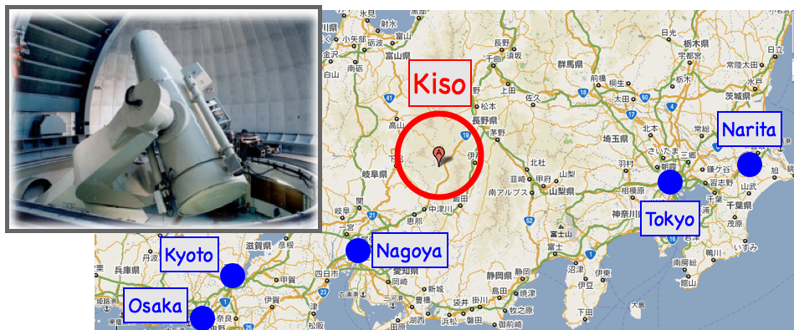
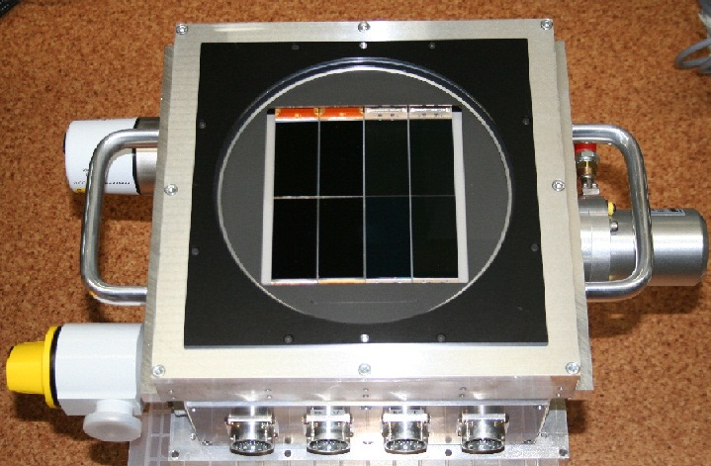
Test Follow-up Observation for a Fermi GBM alert w/ Kiso-Schmidt/KWFC
Kiso Schmidt telescope (1.05m) + Kiso Wide Field Camera (KWFC; Sako+2012, SPIE)
2.2 x 2.2 deg2 field-of-view, 8 CCDs (2k x 4k)
Quick image subtraction system is almost ready by Kiso Supernova Survey (KISS).
Large storage (30TB) for SDSS reference images is being prepared.
GBM416242156: 2014/03/11, 14:49, UT
Localization error of Gamma-ray Burst Monitor (GBM) from Fermi satellite is comparable to that of GW.
GRB is “MOST_LIKELY”
GBM localization
systematic error: 2-3 deg (Singer+2013)
statistical error: ~3 deg

Slide 25
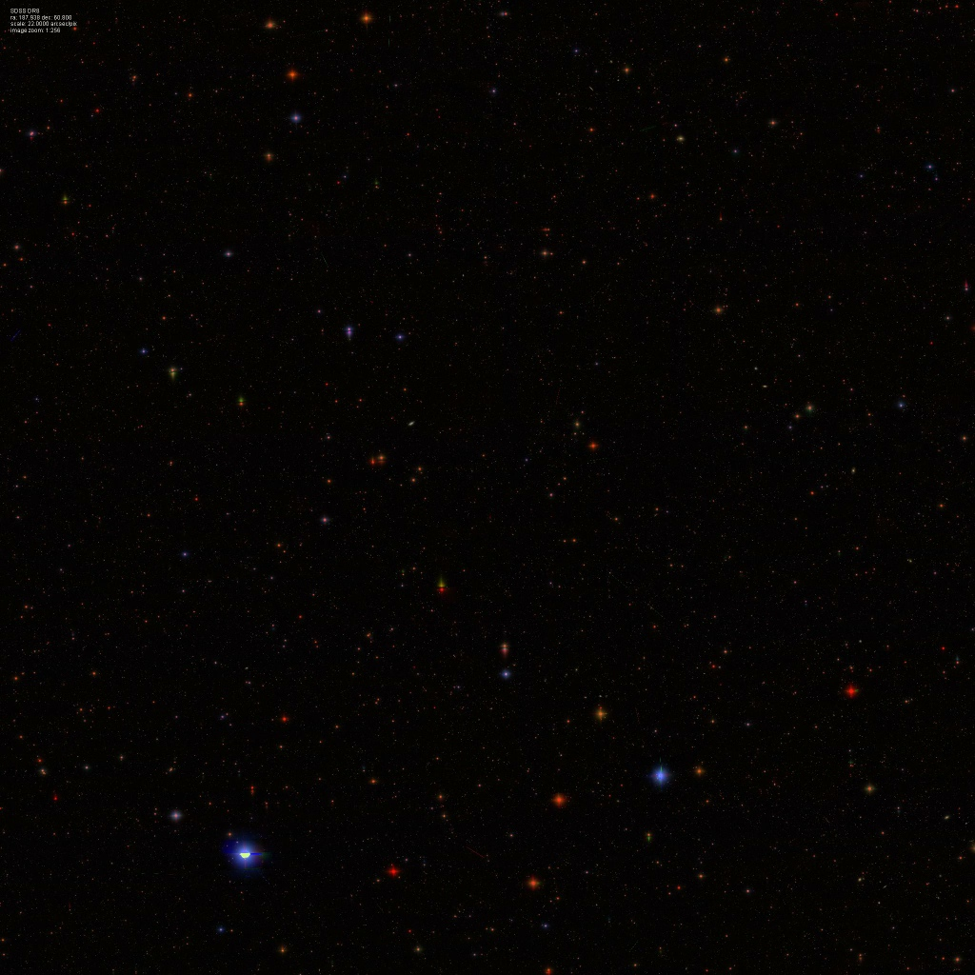
FINAL_POSITION (3.32 deg stat. error)
2 | 2 | 2 | 0 | 0
2 | 2 | 2 | 0 | 0
2 | 2 | 2 | 0 | 0
iPTF possible
counterpart
0 | 1 | 0
1 | 1 | 1
1 | 1 | 1
12.5 deg
SDSS
GND_POSITION (2.72 deg stat. error)

Slide 26
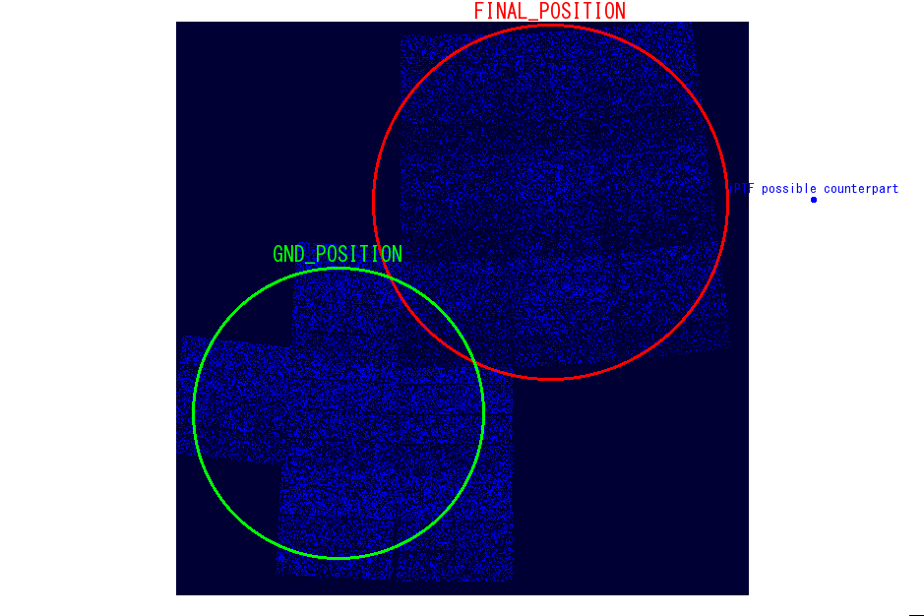
- KWFC 7+9 pointings
- g-band
- 180 sec exposure
# iPTF counterpart could be a ghost... (no X-ray counterpart there by Swift)
KWFC image

Slide 27
Summary
We are developing a coordinated network of optical-infrared-radio observations for follow-up of GW transients, J-GEM.
The network contains several existing small optical-infrared telescopes in Japan, South-Africa, New Zeeland and Chile.
Two new telescopes are under construction (50cm in Tibet and 3.8m in Japan).
We exchanged MoU with the LIGO/Virgo collaboration for EM follow-up this April.

